Slide 1
Studies of a laser-cooled ion source for ultralow emittance beams
FY2024 NPP LDRD Type B Proposal
PI, Presenter: Stephen Brooks
Co-PI: Kevin Brown
March 1, 2023

Slide 2
FY2024 NPP LDRD Type B Proposal
Proposal title: Studies of a laser-cooled ion source for ultralow emittance beams
Primary Investigator: Stephen Brooks
Other Investigators: Kevin Brown (co-PI), Dejan Trbojevic, George Mahler
Indicate if this is a cross-directorate proposal. Yes ___ No_X__
If yes, identify other directorates/organizations:
Proposal Term: From: 10/1/2023 To: 9/30/2025

Slide 3
FY2024 NPP LDRD Type B Proposal
Studies of a laser-cooled ion source for ultralow emittance beams
Laser-cooled ion traps have been used to prepare groups of ions in very low temperature states (~milliKelvin). We propose to study these ultralow emittance ion beams via both theory/design studies and an experimental test chamber, initially without cooling, which can measure the dynamics of extracting a trapped bunch. This creates research opportunities in low emittance beam dynamics: formation of crystalline beams, new methods for creating high brightness ion beams (e.g., sympathetic cooling, higher average current), and exploring the limits of dense beams, for instance producing a very intense focal point limited by Coulomb repulsion instead of emittance.
Program: NP, with benefits for ARDAP, Multiprogram.
Return on Investment: Potential future funding from DOE Office of Science - NPP, ATRO. Potential SBIR and SBTT opportunities.
Broader impact on the activities at the laboratory: This is exploratory, interdisciplinary research. It has the potential to improve beam quality of the hadron facilities at BNL. We expect multiple publications from this work.
Total planned funding per year in FY24 and FY25
Total Funding $200k $200k

Slide 4
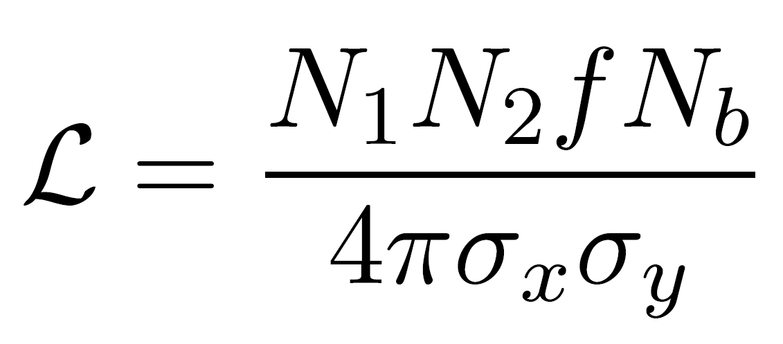
Motivation: High Specific Luminosity
In luminosity formulas, beam size σ* is on the denominator
  This is proportional to emittance (ε) for fixed opening angle σ’*
  Scaling {N → N/10, ε → ε/10, σ* → σ*/10, σ’* constant} gives the same luminosity for fewer particles
    (In 3D, longitudinal emittance and bunch length must also reduce)
  Magnet strengths, space charge and beam-beam tune shift stay constant too
Laser cooled ion traps can provide very small emittances in all three planes
  E.g. ε_{norm,rms}~10⁻¹³ m or even lower at S-POD, Univ. of Hiroshima
  A million times smaller than traditional ion sources ε_{norm,rms}~10⁻⁷ m
Large headroom here for greater efficiency, making the same luminosity with lower currents
  Emittance at collision would likely be dictated by accelerator equipment jitter rather than the source emittance

Slide 5
Ion Trap Test Chamber
Flexible source with variable parameters over wide range:
  Bunch charge
    Via gas pressure, trap voltage
  Bunch size
    Via trap voltage, collimation
  Emittance/temperature
    Stop cooling part way
  Ion species
    Use sympathetic cooling - mix coolable ion e.g. ⁴⁰Ca⁺ ion in contact with desired species
  Easily exchangeable electrode configurations
Learn from existing skills
  BNL ion sources, RF
  Ion traps in universities, etc.
  Beam laser cooling at accelerator labs
e.g. CCD camera to detect fluorescence
Laser
Window
Diagnostics window
Longitudinal trap electrodes with injection / extraction hole
Transverse trap electrodes
Gas input, oven
Port for future injection
Ions
Port for extraction
Vacuum pump, pressure gauge
Interface for different electrode configurations
Destructive diagnostic (MCP or CCD)
Trap voltage feedthroughs
from RF source
Also will include electron gun (or high voltage electrode gap) to establish plasma

Slide 6
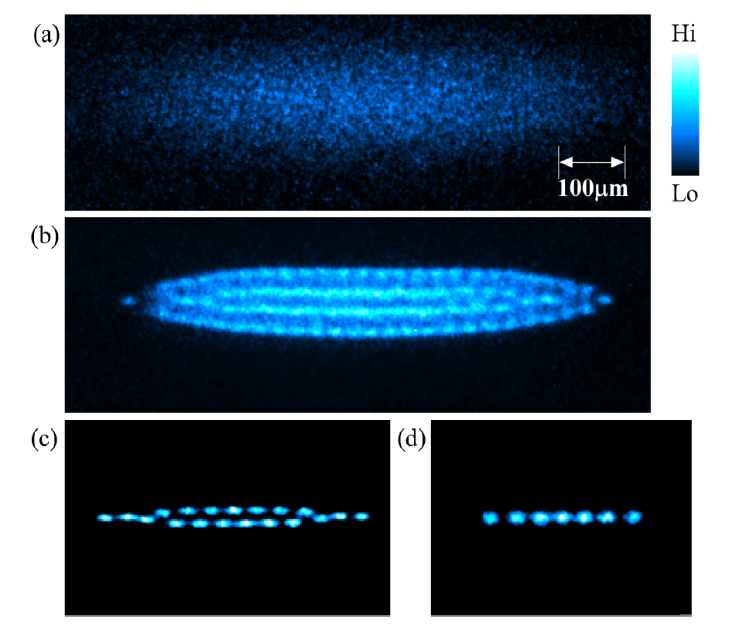
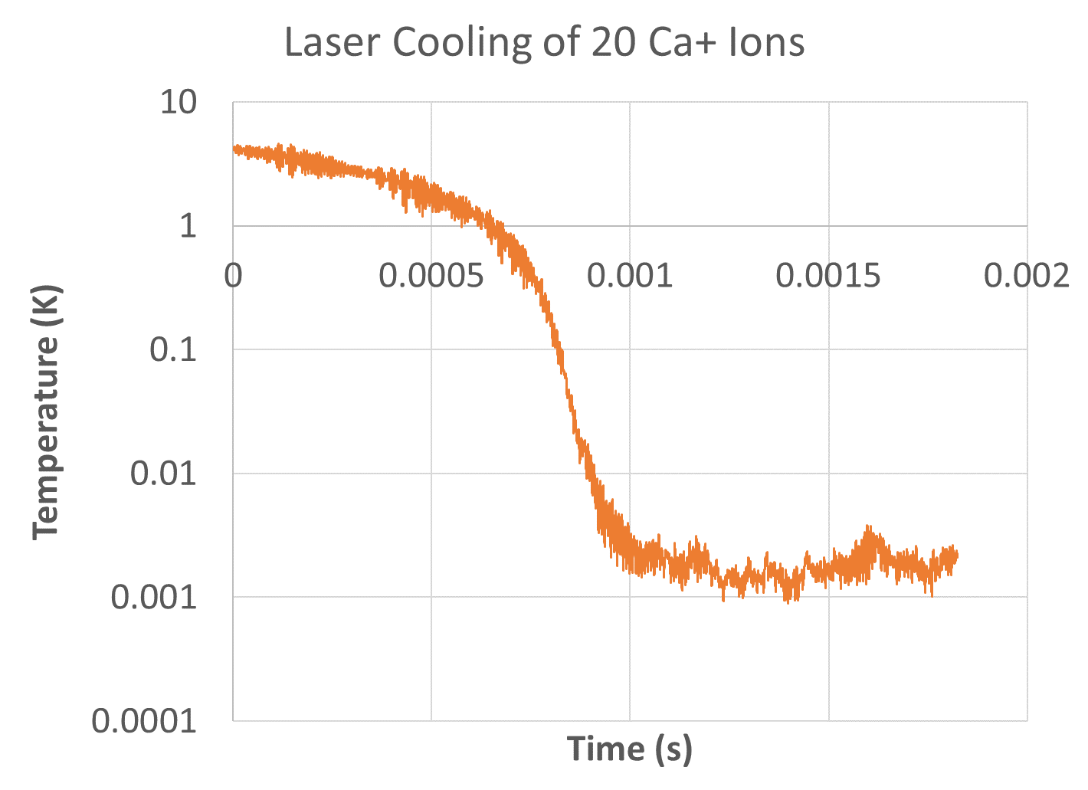
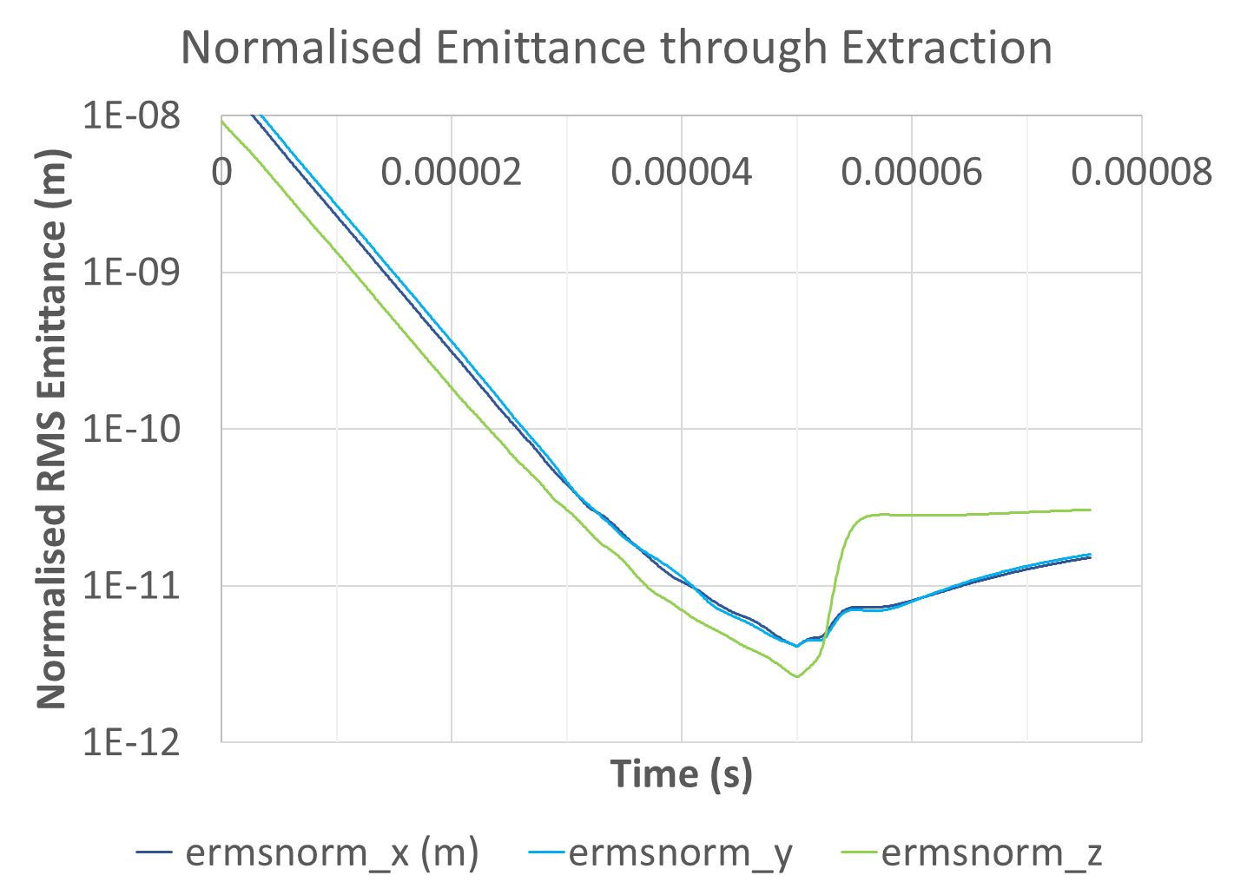
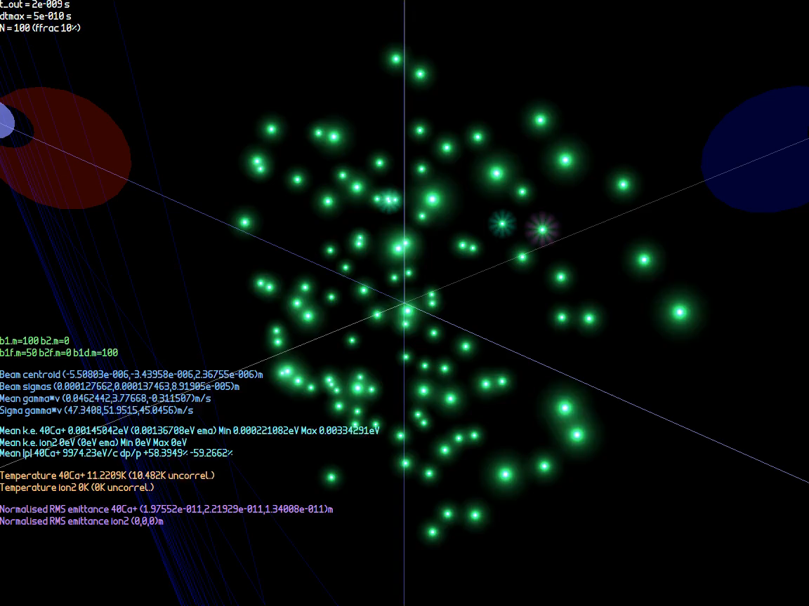
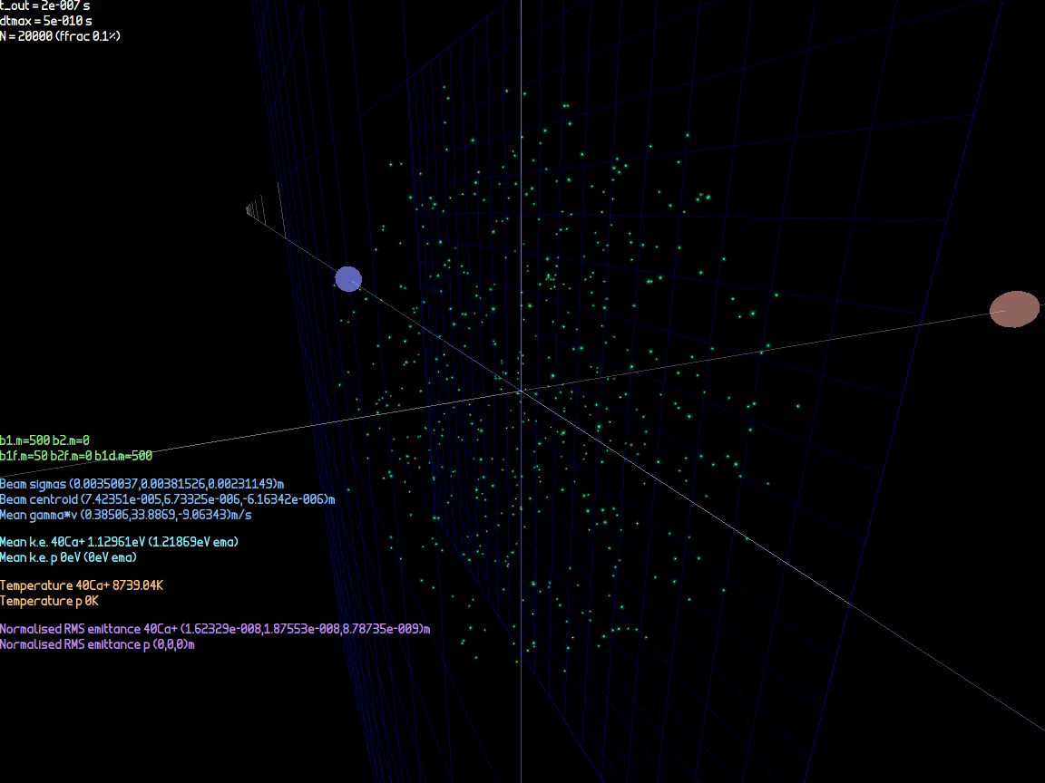
Coulomb Crystal Simulations
1mm
Above: Fluorescence of Coulomb crystal in S-POD trap, from K. Izawa et al., J. Phys. Soc. Jpn., Vol. 79, No. 12 (U.Hiroshima)
Below left: Full cycle of 6-laser cooling (optical molasses) of 100 Ca⁺ ions → Coulomb crystal
Below right: Extraction of 500 Ca⁺ ion Coulomb crystal

Slide 7
Project Goals, Deliverables, Methods
Goals:
Design an ion trap test bench for laser cooling studies and construct a basic foundational system
Develop and characterize low emittance beam applications
Deliverables:
Publications based on design, theory, and simulation efforts
Initial test bench capable of measuring ion bunch trapping and extraction, future platform for cooling experiments
Methods:
Design and simulation studies to identify components to be used in test stand and determine beam parameter ranges
Theoretical work to focus on cooling methods, improving cooling throughput, molecular dynamics models
Particle tracking of manipulating and focusing Coulomb crystals in beamlines, with magnetic aberration correction

Slide 8
Personnel, Procurements
Direct Personnel:
Stephen Brooks: design, simulations
Kevin Brown: physics, theory
George Mahler: engineering design
Dejan Trbojevic: atomic physics
Procurements:
Vacuum chamber (in hand, no cost)
  Cleaning and preparing vacuum chamber
Materials for ion trap, imaging system, vacuum systems, power supplies
Lasers & optics for cooling ~$100k total, may be possible

Slide 9
Summary
This project will focus on two specific things:
The design and construction of a basic test bench to begin learning and developing ion trapping techniques
Studies of physics applications that a cooled ion trap could provide in an accelerator setting
The motivations are:
New way of producing charged particle beams
  Near-zero entropy & temperature (“ideal experiment”), quantum limit
  Cold ion source test chamber has synergy with BNL ion source technology
  Investigating the average current limits of a cooled ion source
  Developing new techniques for 3D cooling of beams
Underlying technology for (future) high efficiency, high specific luminosity colliders
  Turns a power/intensity problem into a precision problem to get luminosity
  With increasing energy and precision, can create high density matter and N-way collisions (fusion)
  Could inject low-emittance bunches into RHIC accelerator chain as diagnostic
Theoretical interest
  Improving our understanding of the fundamental limitations in creating ultralow emittance beams and associated phenomena
  Understanding the formation and structure of crystalline beams
Cooled ion traps are commonplace for atomic physics but novel as accelerator sources, only one or two groups worldwide studying them
  One group has already applied nanobeams to nitrogen ion implantation in diamond

Slide 10
Backup

Slide 11
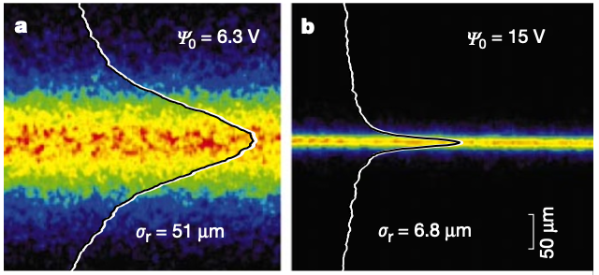
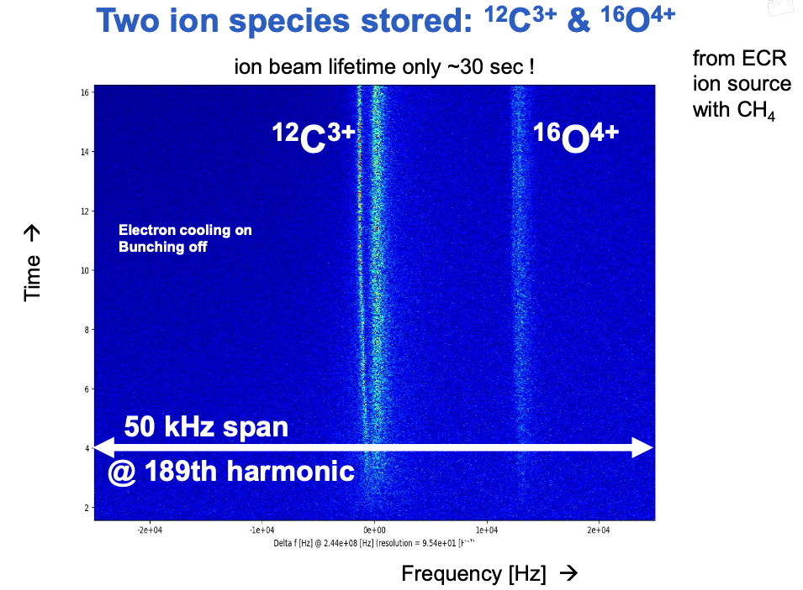
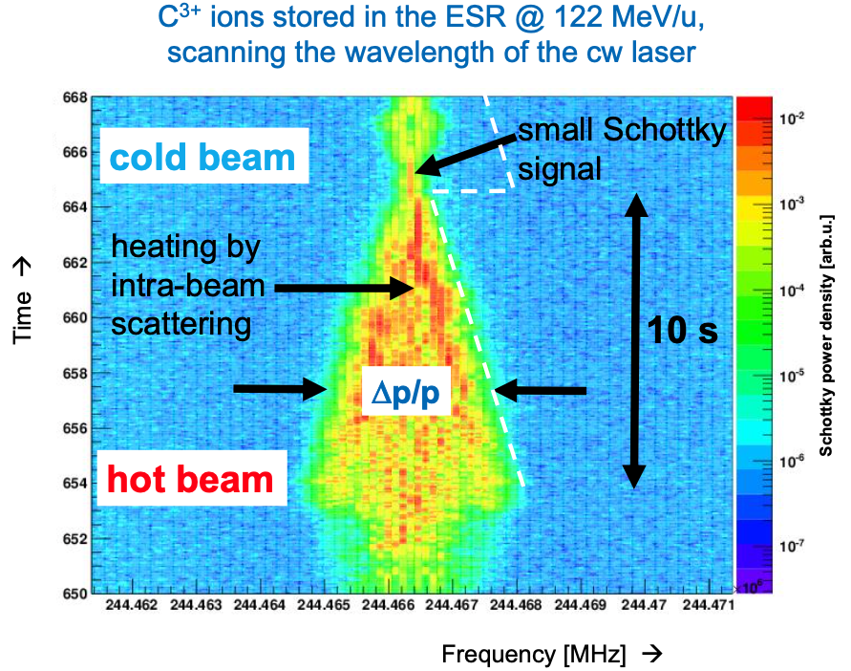
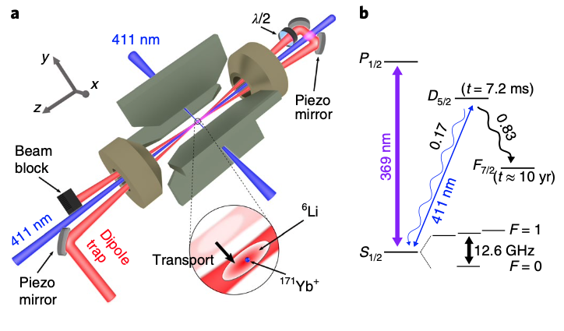
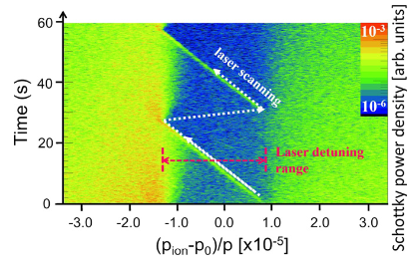
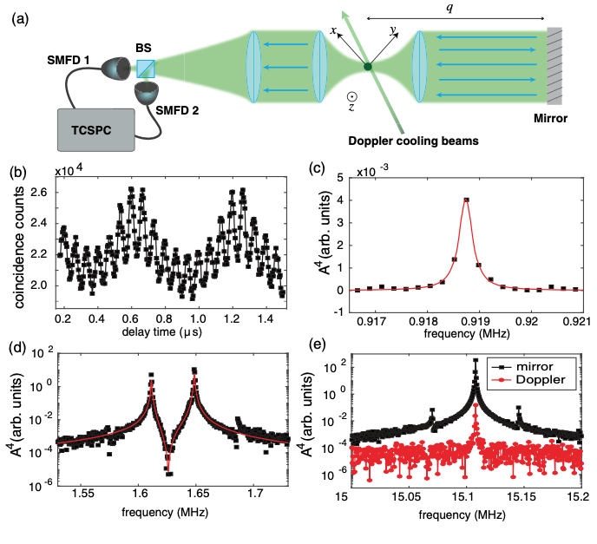
Laser Cooling Experiments References
Transverse beam profiles before and after laser cooling phase transition (from cold unordered beam to ordered/crystalline beam)
U Schramm, T Schätz, M Bussmann and D Habs
Plasma Phys. Control. Fusion 44 (2002) B375–B387
Measuring Ion Oscillations at the Quantum Level with Fluorescence Light
G. Cerchiari, G. Araneda, L. Podhora, L. Slodička, Y. Colombe, and R. Blatt
Phys. Rev. Lett. 127, 063603 – Published 4 August 2021
Buffer gas cooling of a trapped ion to the quantum regime
T. Feldker, H. Fürst, H. Hirzler, N. V. Ewald, M. Mazzanti, D. Wiater, M. Tomza and R. Gerritsma, Nature Physics Vol 16 April 2020 413–416
D Winters, et al., Laser cooling of relativistic heavy-ion beams for FAIR,
Phys. Scr. T166 (2015) 014048 (6pp)

